Slide 1
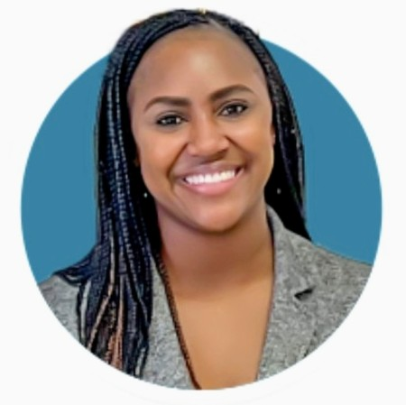

Michelle Anthony
Regional Director
Arizona, Colorado, Idaho, Kansas, Nebraska, New Mexico, N. Dakota, Montana, Oklahoma, S. Dakota, Texas, Utah and Wyoming
Notes:
Hello CO Program Partners! My name is Michelle Anthony and I am one of 5 U.S Regional Directors with the Dollywood Foundation supporting Dolly Parton’s Imagination Library. It is an honor to be employed with the Dollywood Foundation and to be here with you all today.
As you can see I serve 13 states all within the mid west region. But obviously Colorado is my fave, which is why I'm here with you all today

Slide 2
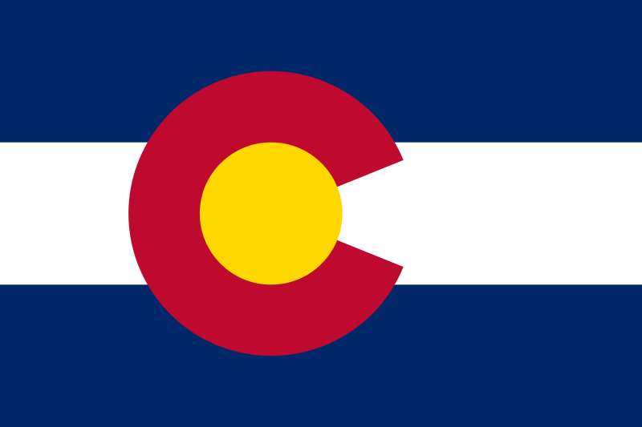

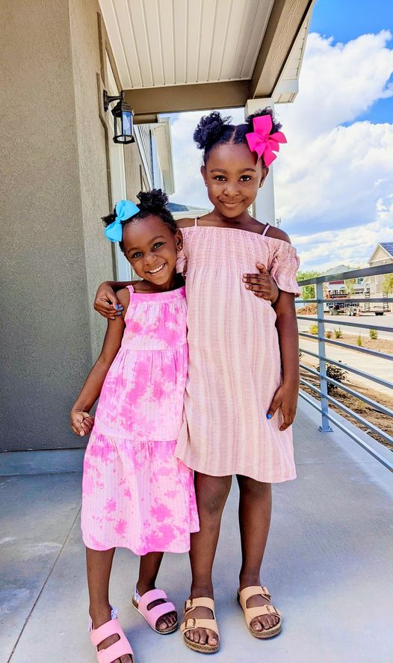
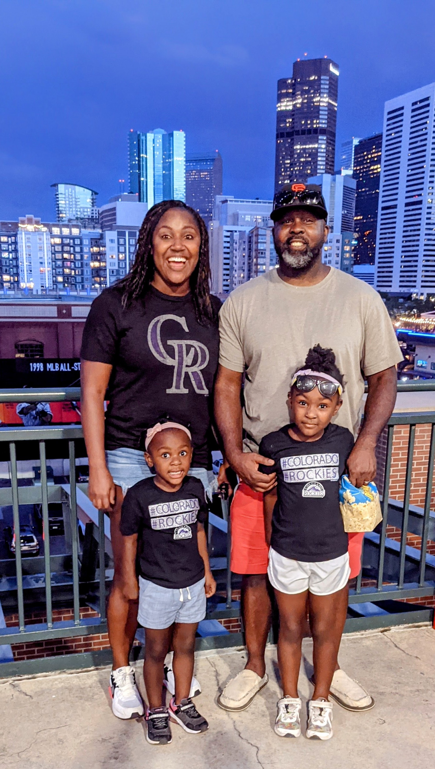
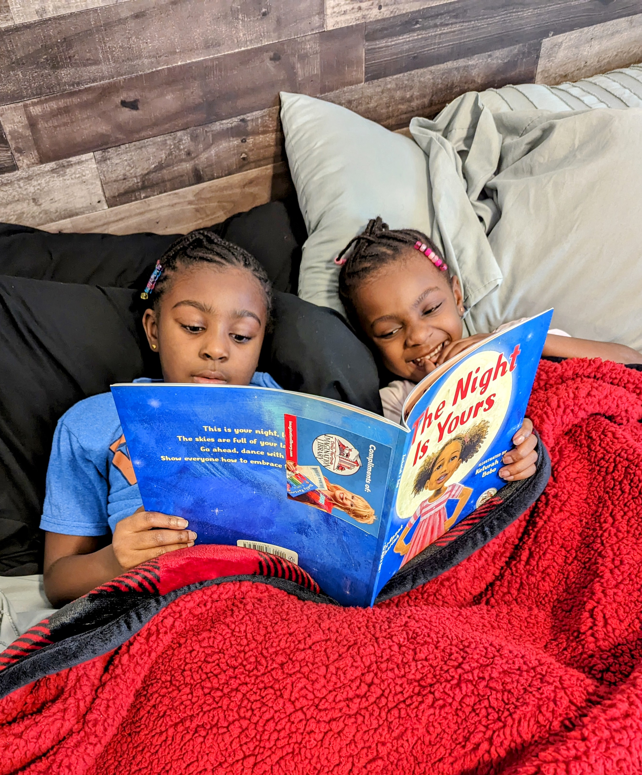


A Little About Me:
I’m a Denver Native!
I earned my BA from The University of Northern Colorado – GO Bears!
Youth serving organizations are my jam – My entire career has been spent in youth serving non-profits
I have been married to my hubby for 9 years
We have two daughters, Presley (8) and Sydney (5)
The four of us are sports
junkies!
Notes:
I thought I’d start today with telling you all a bit about me and my background.
I was born and and raised here in Colorado. I went to Gateway High School in Aurora and after high school I went an hour north to Greeley where I earned my BA in sociology
Youth serving non-profits are my jam. I’ve worked in them my entire career. The past 15 years I spent working with the Girl Souts of USA.
I’ve been married to my hubby for 9 years this past March and we have two daughters, Presley and Sydney. Unfortunately my husband and daughters culd not be here because they are at a make up soccer game. With all this crazy weather they’ve had to reschedule several games and one happened to be tonight.
Last thing all share about us is that we are sports junkies. We love cheering on all the CO teams, right now it’s all about the Nuggets in the playoffs.

Slide 3
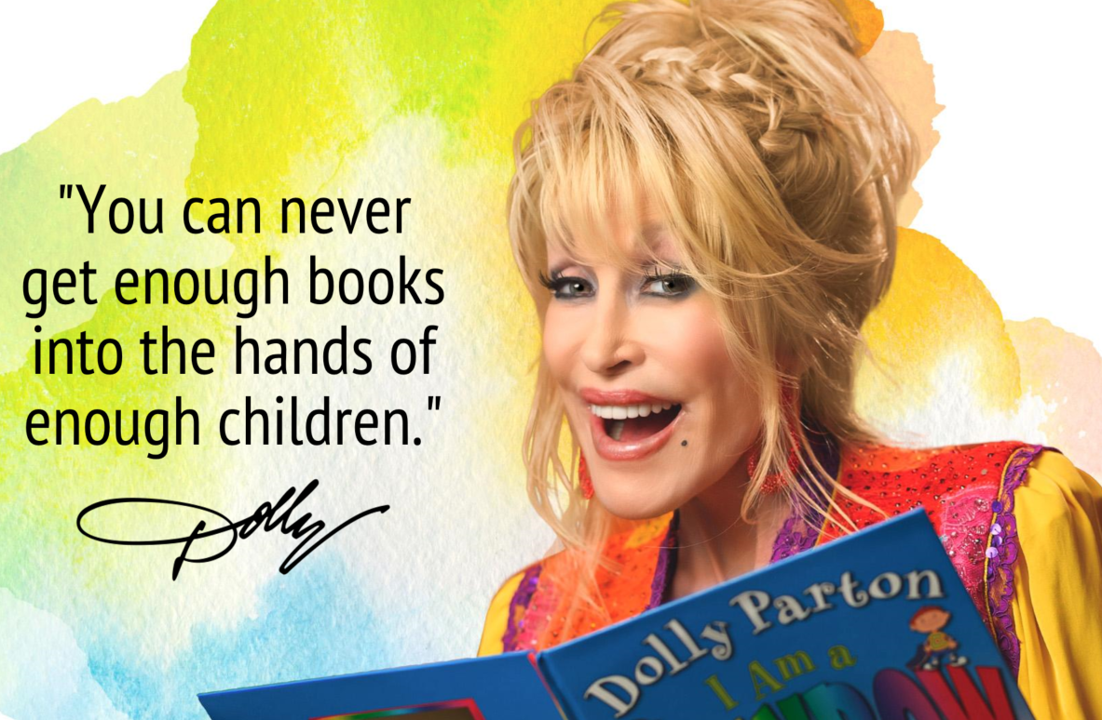
My Why
Positive Impact on Children:
Families connect around reading and stories
Build home library of 60 books
30% increase in Kindergarten readiness
Fulfillment:
Anti-literacy laws enacted in this country from 1740 and 1834 prohibited people of color, freed or enslaved from learning how to read and write
All kids, no matter where they come from or what they look like, are getting the opportunity to read.
I can’t wait to learn about YOUR why!
Notes:
So I’ve been asked by so many why after 15 years I chose to switch careers. I am certain that most of you can relate to this and it’s the Impact that this program has on kids. Families connecting around reading together, kids who go through the program end up with a library of at least 60 books and data says that reading before Kinder shows a 30% increase in Kinder readiness.
As I get to know all of you, I look forward to learning about your why
On a more personal note – in the 17 and 1800’s, it was illegal for my ancestors in this country whether they were freed or enslaved to learn how to read and write. .
So as a descendant, it’s incredibly fulfilling for me to be a part of Dolly’s dream to get books into the hands of kids no matter what color their skin is.

Slide 4
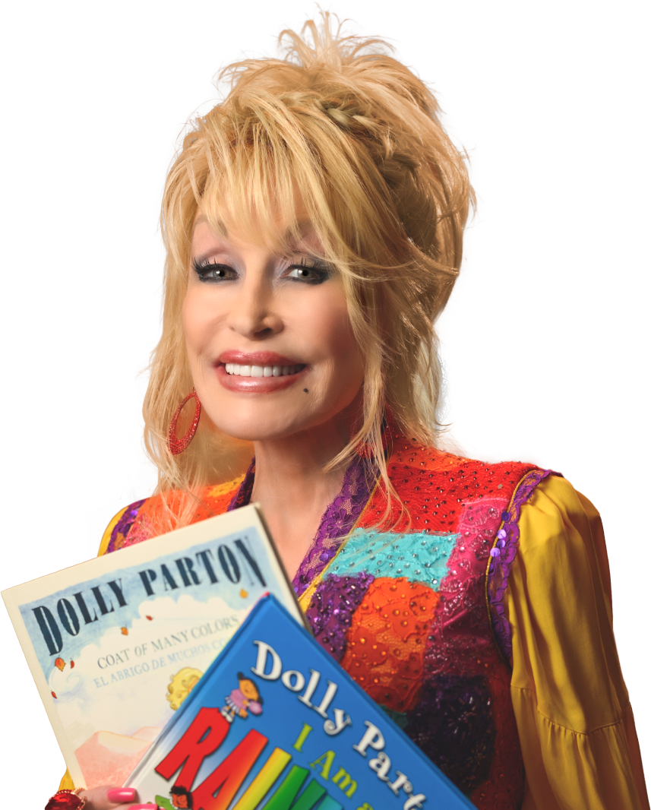
What’s New at The Dollywood Foundation
  We’re growing and growing and growing
Total Books Gifted since inception: 209,007,147 in 5 countries(U.S., Canada, UK, Aus., Ireland)
Total Books Gifted since inception in U.S.: 2,261,470
Total Children registered: 2,308,256 in 5 countries
There is a newly updated Operations Manual
and Brand Guide on the Imagination Library Website
Notes:
So What’s new at the Dollywood Foundation? I’m going to share more of a high level overview and Jack wil talk more about CO specifically
Total Books Gifted since inception: 209,007,147 in 5 U.S., Canada, UK, Aus., Ireland
Total Books gifted in U.S. is 2,261,470
Total Children registered: 2,308,256 in 5 countries
And a couple marketing updates here, there is an updated ops manual and brand guide.

Slide 5
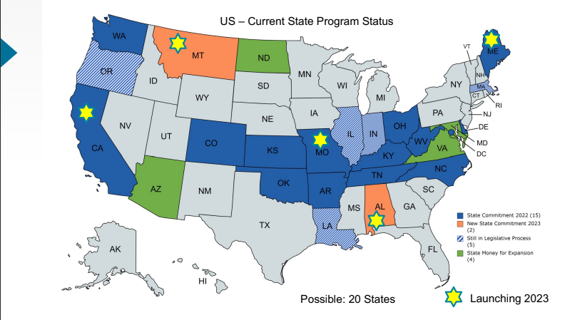
Notes:
Here I the U.S there has been really incredible growth over the past few years
We have a total of 15 states that are fully committed, meaning they are working to cover ensure ever child 0-5 in the state has access to DPIL books – Colorado is one of them!
Montana and Alabama, Missouri, Maine and Cali are set to launch this year
5 states are in the legislative process and which means they are set to be committed in the next year or two
And we have a few states that are working to expand their current programs

Slide 6

Dream More Learn More Care More
Be More!
Contact me: manthony@imaginationlibrary.com
Direct Line: 865.280.2782
Notes:
That is all I have.
Thank you all for having me!
Are there any questions I can answer?

